Slide 1
Lecture
Custom Controls

Slide 2
Custom User Controls
Writing reusable code is good programming practice.
Creating custom user controls allows you to reuse components in other ASP.NET pages or projects.
A custom user control is a special type of ASP.NET page that can be included in other ASP.NET pages
It has the .ascx file extension.
There are similarities that exist between ASCX and ASPX pages:
You can use the VS Designer to easily create the control.
They both have a code-behind class that gets instantiated and can call other components.
They have page-level events like the Page_Load and Page_Init that you can handle in the code-behind.

Slide 3
Creating Custom User Controls
You can create reusable custom user controls in ASP.NET in a few simple steps.
First, you create an ASCX page and use the designer much like you would for an ASPX page.
Next, you implement the code for the control and expose any properties that will be utilized by the page that will contain the control.
Lastly, add the control to the pages that use it and set the necessary properties of the control.

Slide 4
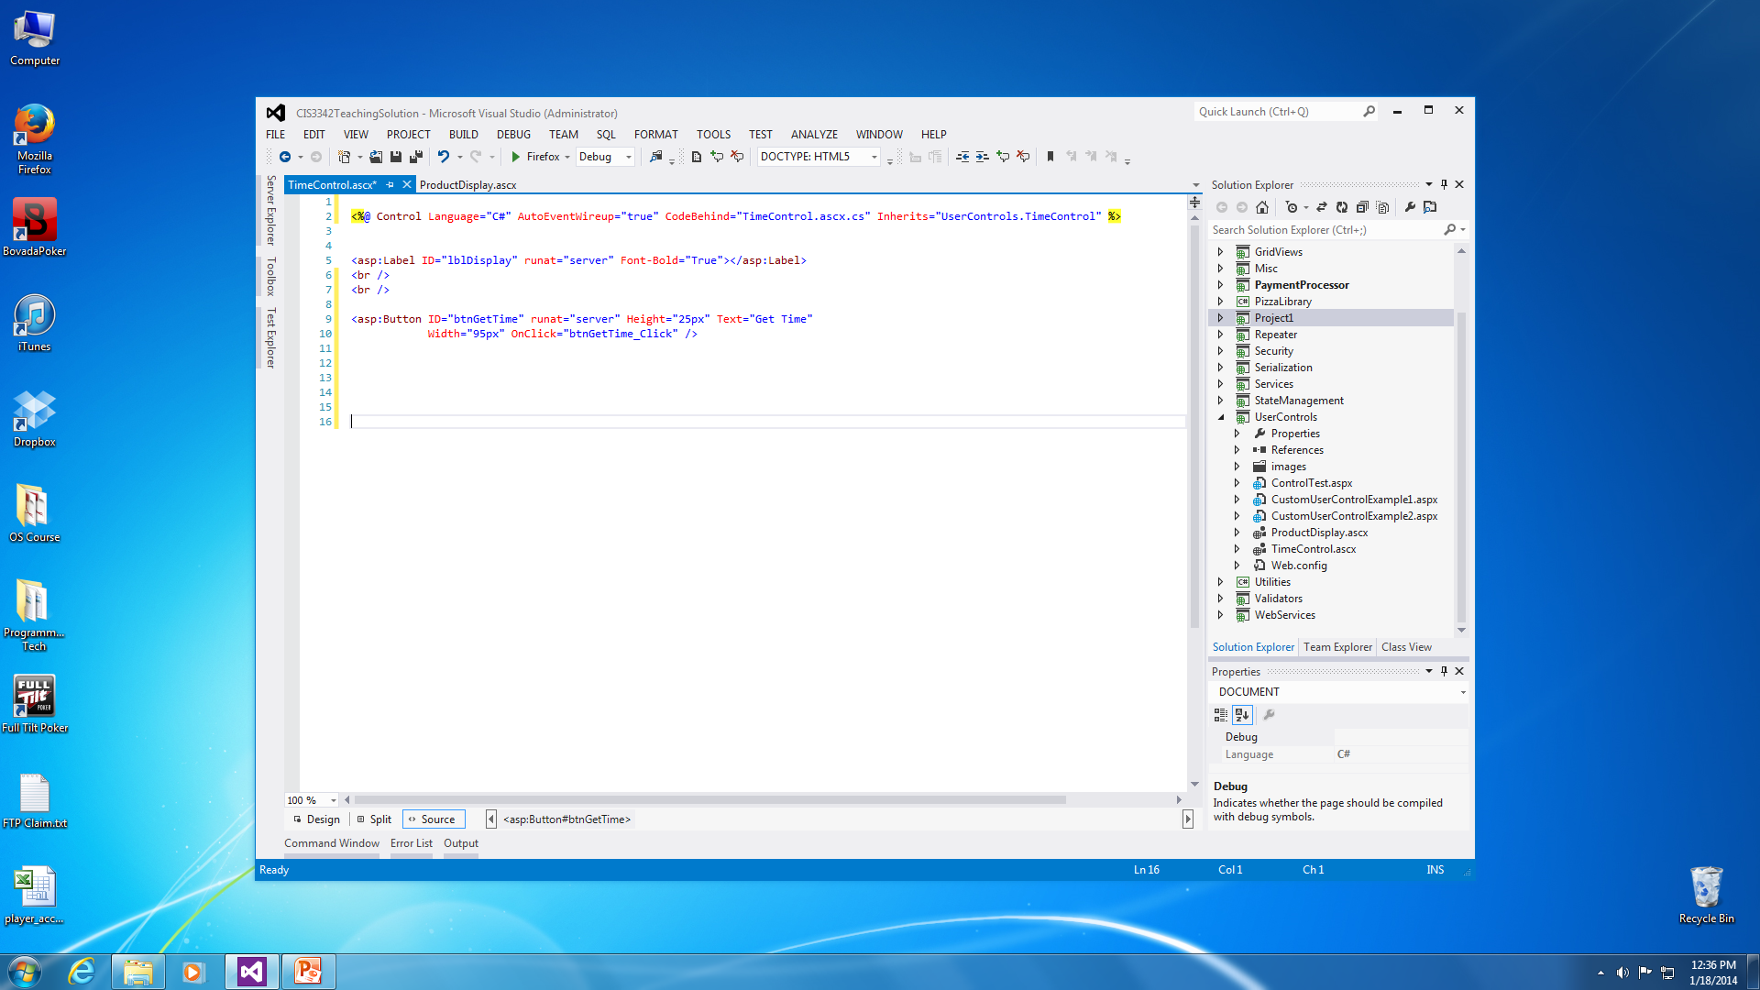
Concepts: Code Generation
ASCX file markup code generation
It contains only the page directive for the ASCX file and any markup code for elements you add in the designer or write manually.
It doesn’t contain important HTML (html, head, and body tags) because this control is added to an ASPX page that will already contain these elements.

Slide 5
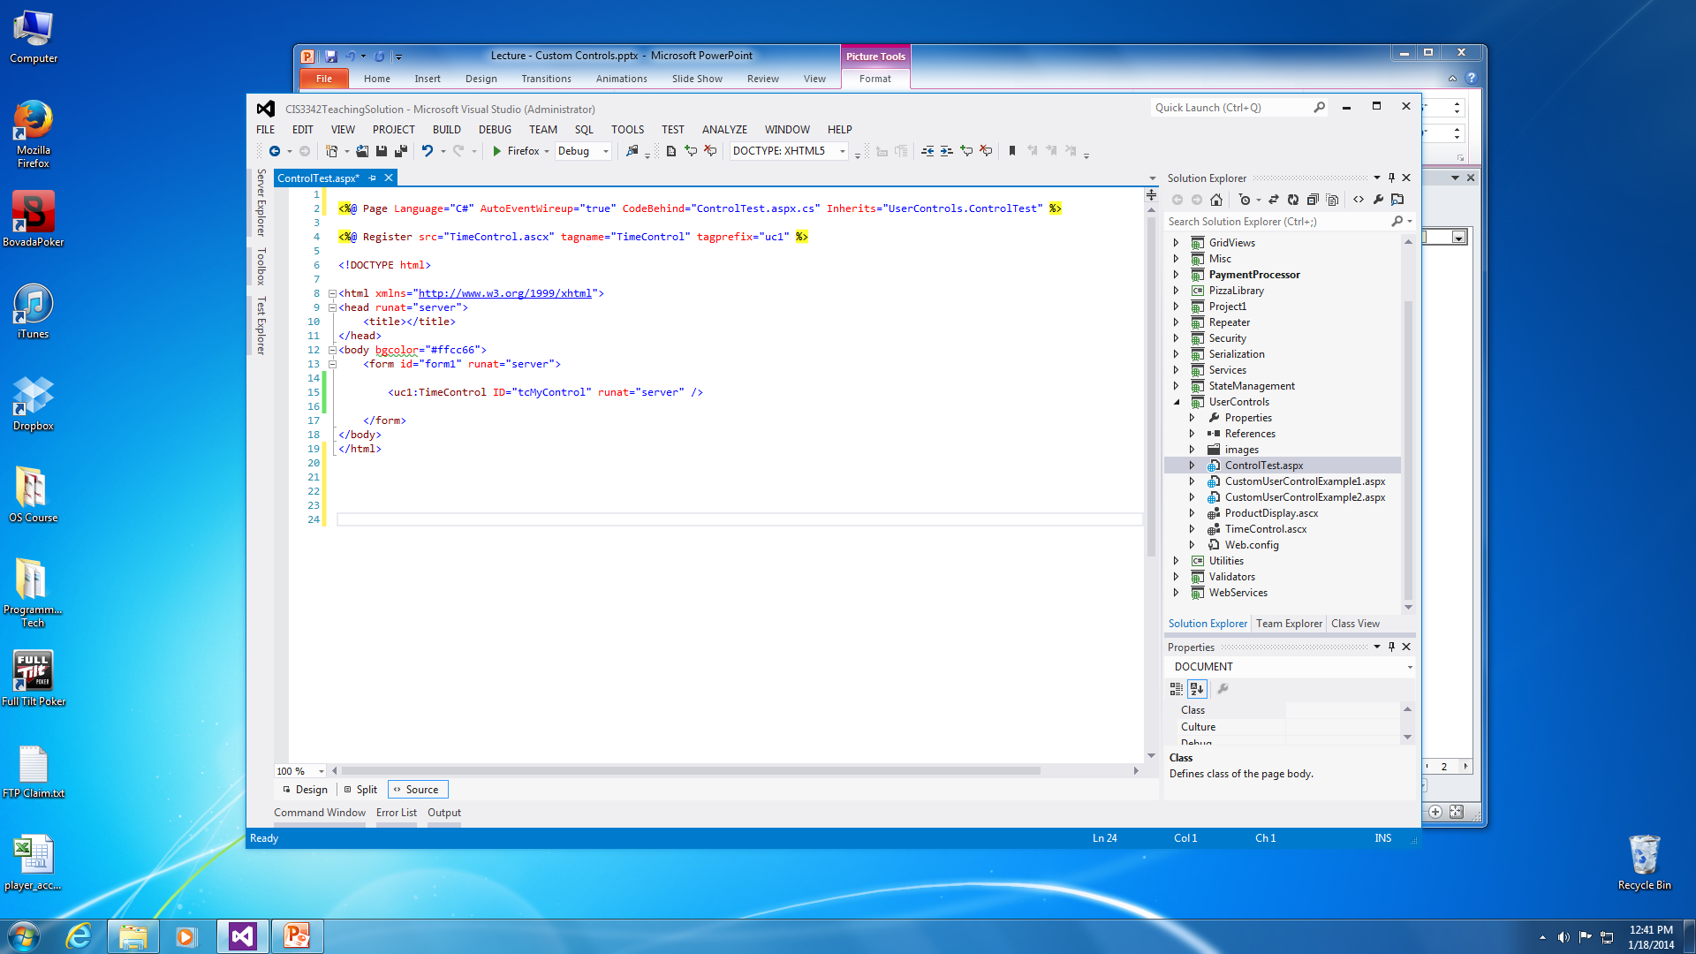
Concepts: Code Generation
ASPX file markup code generation for a page with an ASCX added to it.
When you place an ASCX file into an ASPX page it generates a few important lines of code.
It adds a page directive to register the control for the page and the markup for the control.

Slide 6
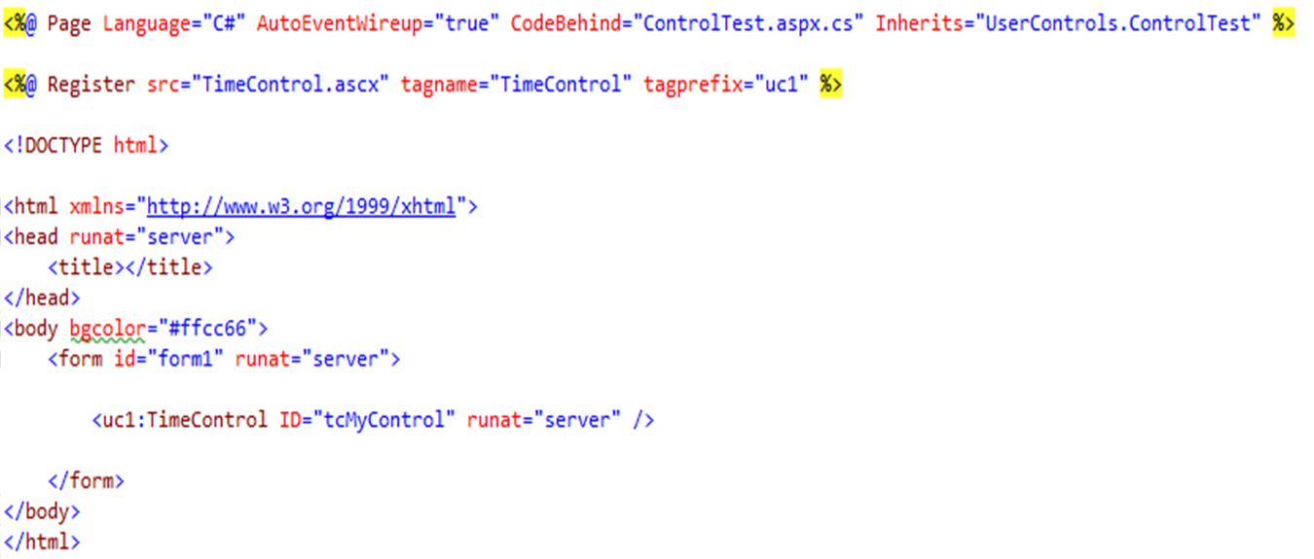
Concepts: Code Generation
The code generation identifies the control and allows you to use it on the ASPX page.
Tagprefix – an arbitrary alias for the namespace the control will exist.
Tagname – an arbitrary alias to associate with a class.
Src – the location of the code that defines the control (path and name for the ascx file).
Tagprefix
Tagprefix
Notes:
Tagname – a name by which the control will be referred to. It has to be unique within the namespace
Tagprefix – the namespace the control will exist. You can have multiple controls with the same tagname as long as they have a different tagprefix.

Slide 7
Concepts: Events
Before you can begin coding the control, you need to understand the sequence of events that are raised for a page that contains user controls.
The Page_Load event fires for the ASPX page.
The Page_Load event fires for each user control (ASCX).
The control event caused by user interaction with a control on the page.
The control can be from the ASPX page or the ASCX controls added to the page.
The PreRender event for the ASPX page.
The PreRender event for the user control (ASCX).
The Page_UnLoad event for the user control (ASCX).
The Page_UnLoad event for the ASPX page.

Slide 8
Concepts: Events
ASP.NET begins by raising the Page_Load event for the ASPX page.
Then, it raises the Page_Load event for each user control that the page contains.
The Page_Load events are raised in the order in which the controls are added to the form (order of the HTML/ASPX Markup).
To avoid problems, you should never code user controls to depend on other user controls.
After the Page_Load events for both the page and user controls execute, the control events are raised.
For example, the user clicks a button on the ASPX that contains two custom user controls (ASCX), the code in the button click event is not executed until after the load events for the page and custom user controls.
Finally, the PreRender events are raised.
These events can be used to make last minute changes to controls before they are rendered into HTML.
This event occurs before the render method gets called which creates the HTML code.

Slide 9
Exposing Properties & Methods
Exposing properties and methods for a custom control (ASCX) allows the developer access to elements of the custom control.
In order to expose functions or subs, they must be designated as public in the code-behind of the ASCX.
Example:
public void AddImage() {
}
You need to create public properties to expose variables of the custom control class, or the controls contained in the ASCX file.
Example:
[Category(“Appearance”)] public string SetText {
set { lblDisplay.Text = value; } }
Designer attribute that is used to determine where this property will be located in the Properties Window of the Form Designer
This property is used to allow a developer to place text inside the ASCX file’s label control.

Slide 10
Adding Controls Dynamically
You can dynamically add controls to an ASPX page at runtime.
You need to use the LoadControl method to specify the source of the control and register it.
This method requires the path and filename for the ASCX file.
Once the control is loaded, you need to add it to the Form’s Controls collection.
Example: Control myCtrl = LoadControl(“ProductDisplay.ascx”) ; Form.Controls.Add(myCtrl);

Slide 11
Adding Controls Dynamically
If you need to set specific properties or call methods of the control, then you need to work with an object of the control’s type.
The LoadControl method returns an object of the Control class, which needs to be casted into the specific type of object for your control’s class.
Example:
ProductDisplay myCtrl = (ProductDisplay )LoadControl(“ProductDisplay.ascx”);
myCtrl.SetText = “Here is my text for the control”;
Form.Controls.Add(myCtrl);

Slide 12

That’s All Folks…

